Slide 1


Campus Q&A
CISC3003 Project Report
Campus Q&A
TEAM 04
PAIR 06 | Huang Yanzhen | DC126732
 | Li Ruoxuan | DC027534
PAIR 04 | Chen Zirui | DC127901
 | Guo Pengze | DC127461
PAIR 24 | Chen Pengyu | DC125135
 | Lei Chon Hin | DC026736
Web programming
Notes:
Hello, everyone! We are Team 04. In this digital story, we are going to introduce our project Campus Q&A.
Our Team was formed from PAIR 06, PAIR 04 and PAIR 24.

Slide 2



Table of Contents
PART 01
PART 02
PART 3
Introduction
System Design
System Walkthrough
Notes:
This digital story had been divided into three parts: Introduction, System Design, and System Walkthrough.

Slide 3
PART 01
Introduction

Slide 4
Introduction
Application Domain
In the University of Macau, there has never been a unified school forum.
Therefore, we hope to develop a student forum software, so that
Everyone can freely raise and discuss their questions in study and life and
Get answers from enthusiastic students.
Functions & Descriptions
Campus Q&A is a platform that allows students on campus to ask and answer questions. A student can post a public question for all students to answer, and a student can answer a public question by replying to the corresponding public post.
Target User：Campus students
Technologies：
Front-end: HTML + CSS + JS
Back-end: PHP + MySQL
Notes:
I

Slide 5
Introduction / List of Services
Post a Question
Close / Re-Open a Question
Reply to a Question
Sign up / Delete an Account
Login / Log out an Account
Alter a user name and email
Change User Password
As soon as a question is considered solved by the asker and the asker no longer expect any answers, he or she could close the question. Users could still reply to closed questions.
Notes:
There are a list of services. A user could:
Post a Question, Close / Re-Open a question, ….
Specifically, as soon as a question is considered solved by the asker and the asker no longer expect any answers, he or she could close the question.
However, users could still reply to closed questions.

Slide 6
Introduction / List of Tasks
Task | Work Distribution
Project Coordination & Version Control | PAIR 06, PAIR 04, PAIR 24
Front-end Design & Implementation | All Posts, Login/Signup | PAIR 06
 | All Posts Page | PAIR 04
 | Post Details & User Details | PAIR 24
Backend Design & Implementation | PAIR 06, PAIR 04, PAIR 24
Digital Story Scripting | PAIR 06, PAIR 04, PAIR 24
Project Summarization | PAIR 06, PAIR 04, PAIR 04
Notes:
This is the list of tasks.

Slide 7
Introduction / Source Control
Development Branches
Before: Three branches: modifyCardView, login, postDetails
After: Mainly on dev, adding branches only for unstable increments
Purpose: Reduce Modification Conflicts
Notes:
For source control, we stopped using the three-branch method. That’s because as the project gets mature, multiple concurrent branches may cause modification conflicts.

Slide 8
PART 02
System Design

Slide 9
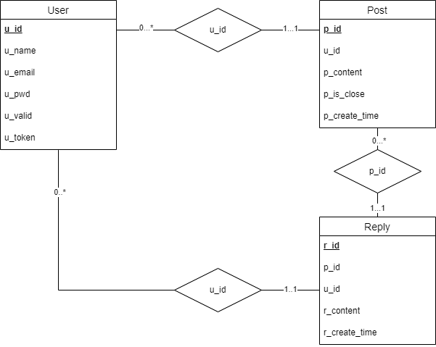
System Design / Database Design
Database: qadb
that is, “Question Posts”
Notes:
The database is made up of three tables: User, Post and Reply.
One user can have multiple posts, one post can be only posted by one user.
One post can have multiple replies, one reply can be only under one post.
One user can have multiple replies, one reply can only be posted by one user.
For user, attribute u_valid is used to record email validation status. U_token is used to record user validation token.
For question post, the p_is_close attribute is to record question status.

Slide 10
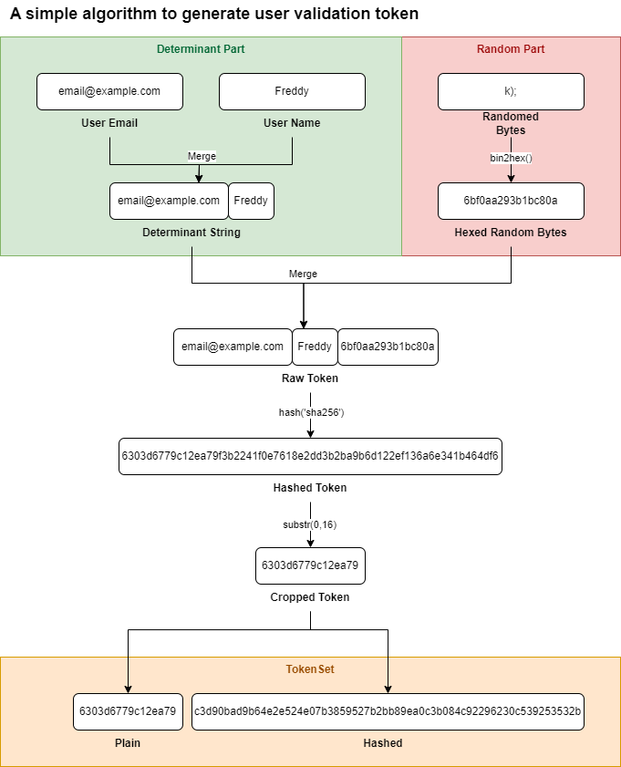
System Design / Tokens
Token validation is used to verify user’s integrity.
Anytime a verification is needed, a new user token will be generated and sent to the user’s email account.
Randomization: Random 8 bytes.
Token generated at different time will be different, even if the user email and user name are same.
TokenSet:
Plain: Plain token to be sent to user email.
Hashed: To store in the database.
Notes:
Token validation ….
Random 8 bytes are used for randomization so that token generated in different time won’t be the same.
Token set stores a pair of tokens: One in plain text to send via email, another hashed to store in the database for validation.

Slide 11
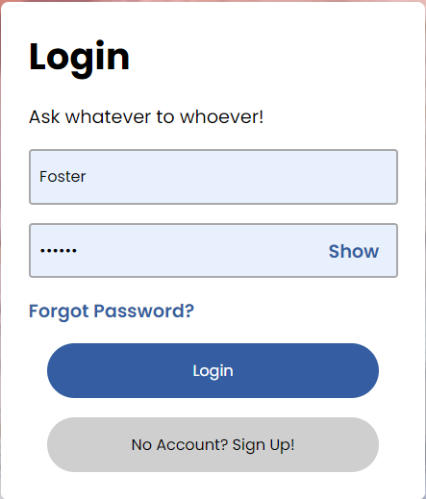
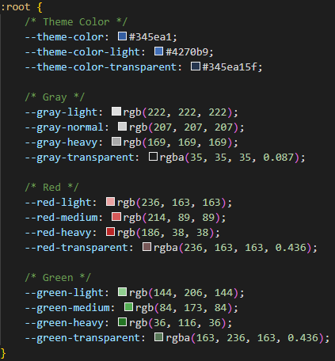
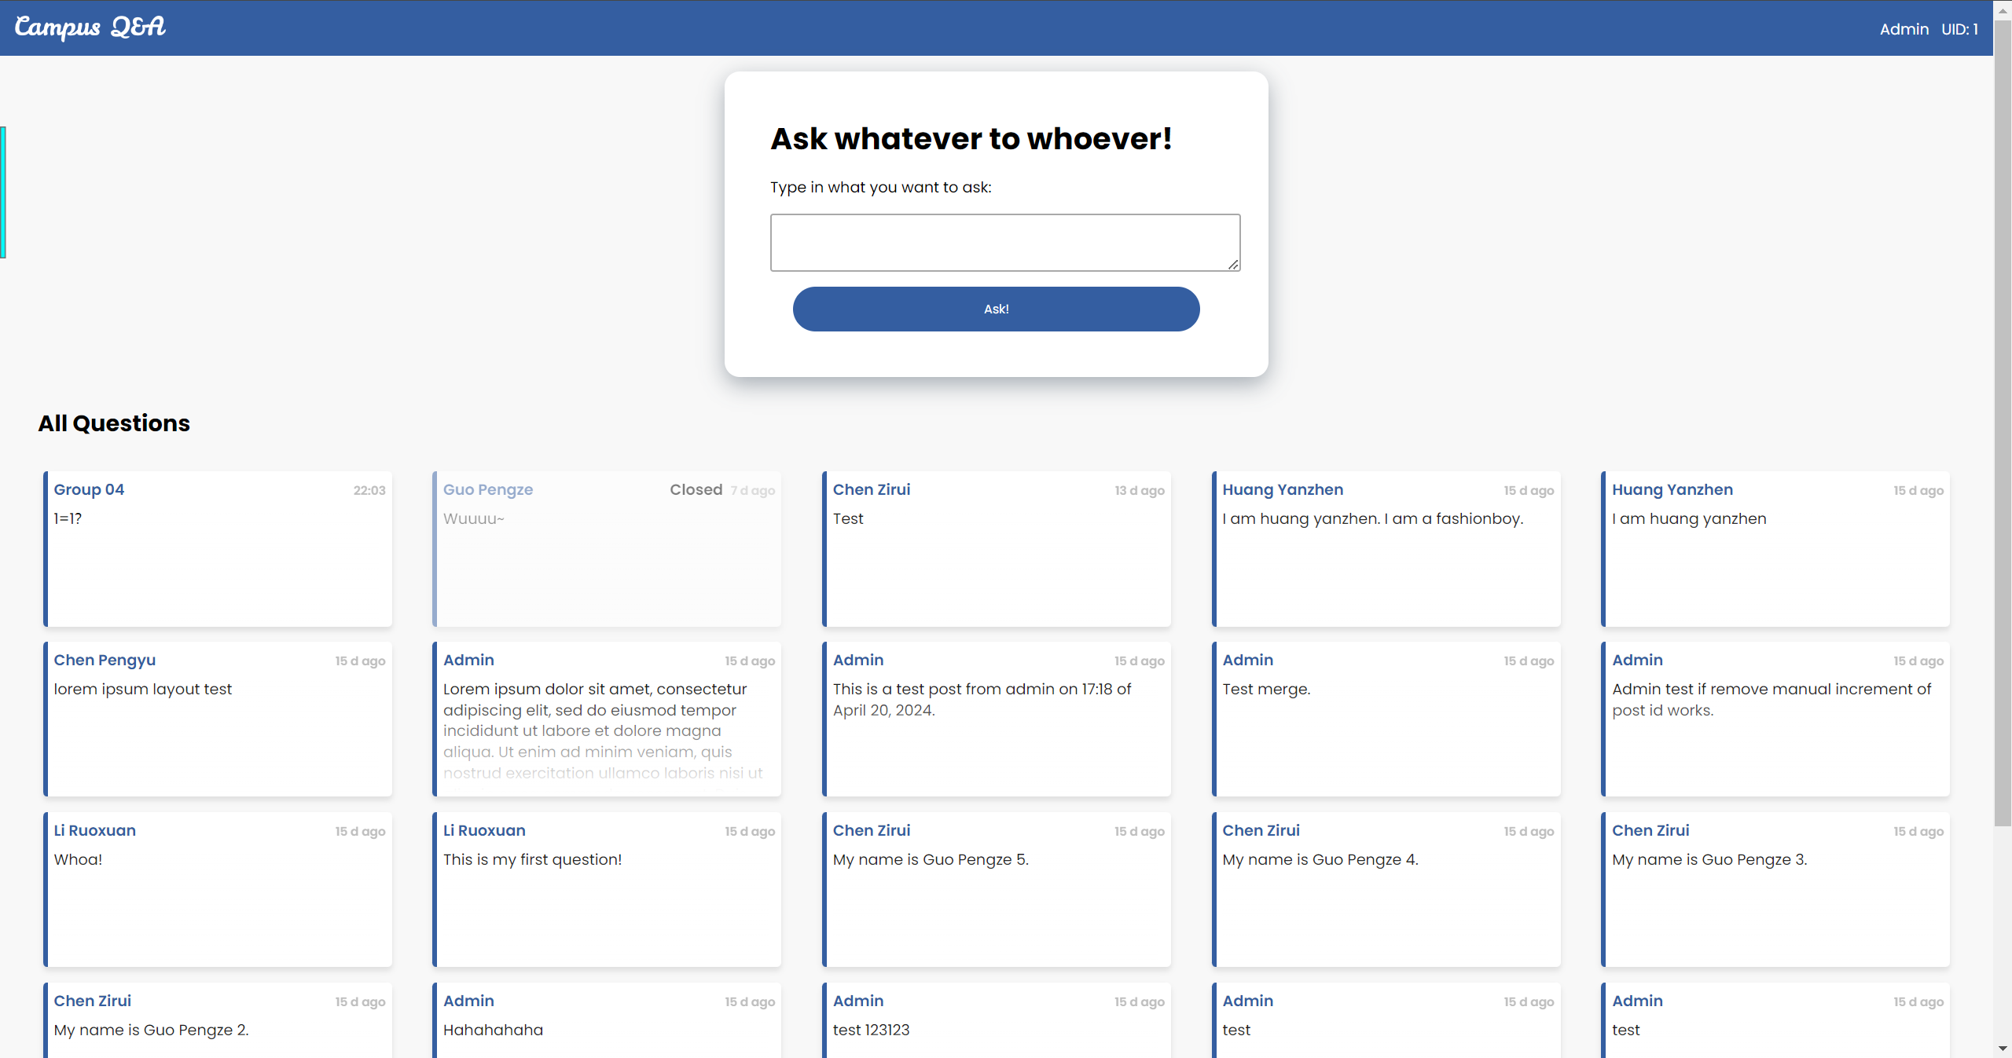
System Design / User Interface
Unified Design Language:
Unified Color Set and Variances
Unified Button Styles
Card View
Google Poppins Font
Responsive Design
Web: Rounded Card, Grid View
Mobile: Sharp Corner Card, List View
Notes:
For user interface, we promoted a unified designing language with unified color attributes and so on.
We also made use of the responsive design to adjust for both web and mobile view.

Slide 12
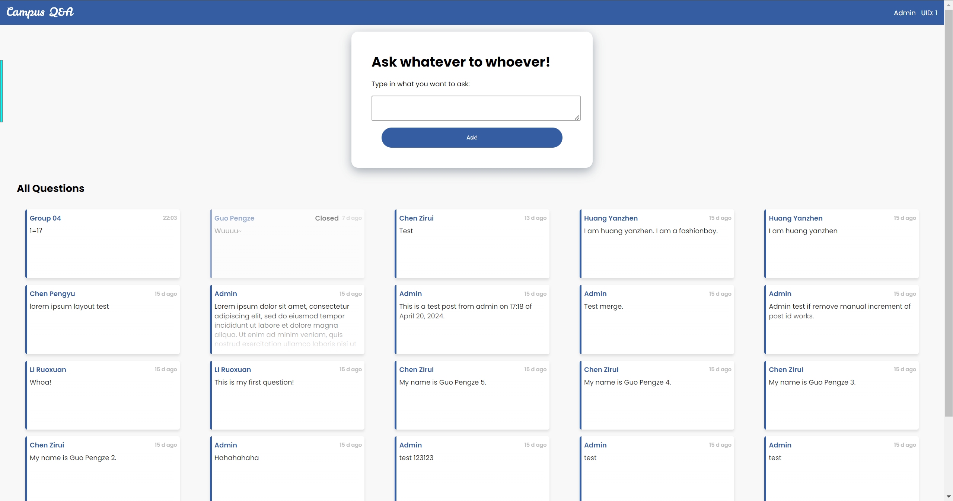
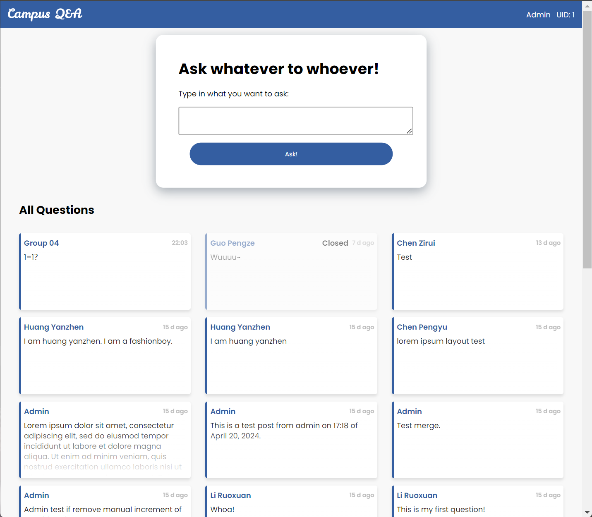
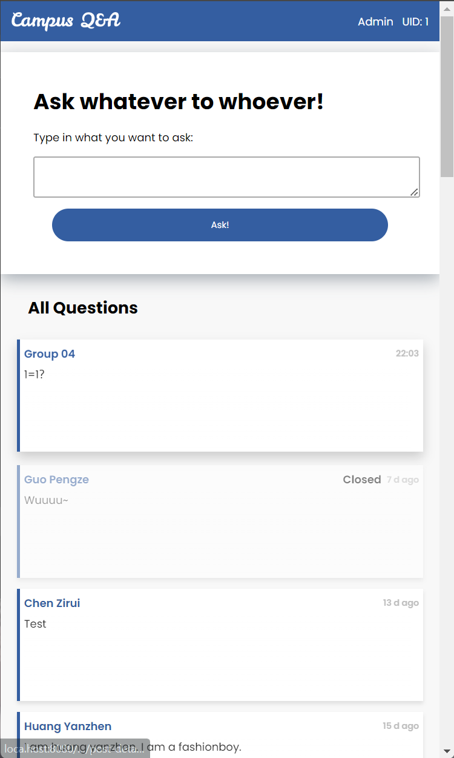
System Design / User Interface / Responsive
narrower
Even narrower

Slide 13
PART 03
System Walkthrough

Slide 14
System Walkthrough / Showcase 1
Showcase 1: Signup & Login
Presenters:
PAIR 06 | Huang Yanzhen | DC126732
 | Li Ruoxuan | DC027534
Notes:
Show case 1: Signup & Login is presented by PAIR 06.

Slide 15
System Walkthrough / Showcase 2
Showcase 2: Post Questions, Reply to Questions
Presenters:
PAIR 24 | Chen Pengyu | DC125135
 | Lei Chon Hin | DC026736
Notes:
Show case 2: Post Questions and Reply is presented by PAIR 24.

Slide 16
System Walkthrough / Showcase 3
Showcase 3: Change user name / email, Change password
Presenters:
PAIR 04 | Chen Zirui | DC127901
 | Guo Pengze | DC127461
Notes:
Show case 3: Change user name or email is presented by PAIR 04.

Slide 17
Thank you for listening!

